Slide 1
跟着Kevin学英语(7)
Mummy Pig at Work

Slide 2
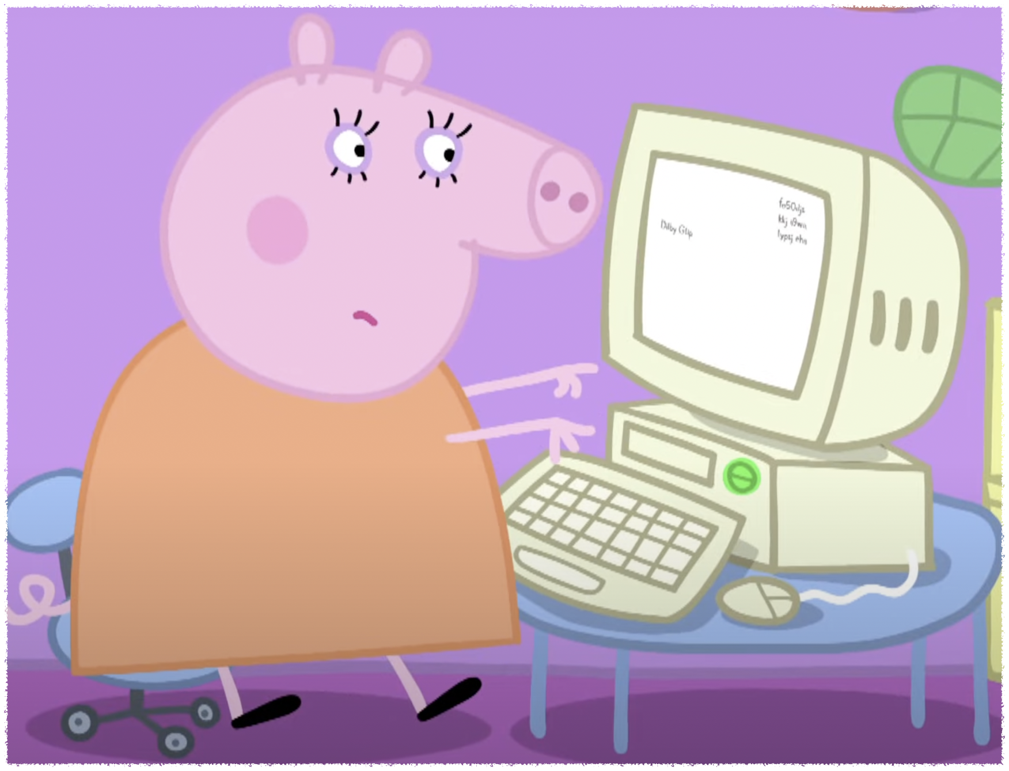
W w
Work
Notes:
Mommy pig is working

Slide 3

C c
Computer
Chicken
Notes:
Can I play that computer game?

Slide 4

C c
Computer
Chicken
Notes:
This is a yellow chicken

Slide 5
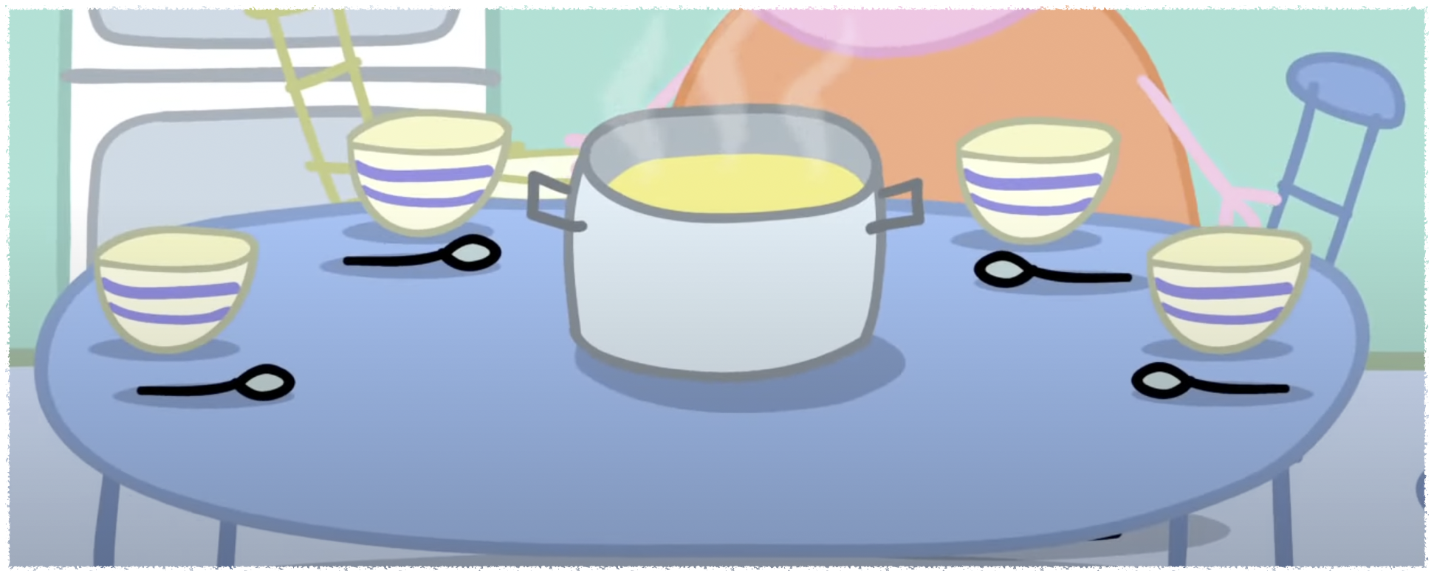
L l
Lunch
Lap
Notes:
We can have lunch together

Slide 6
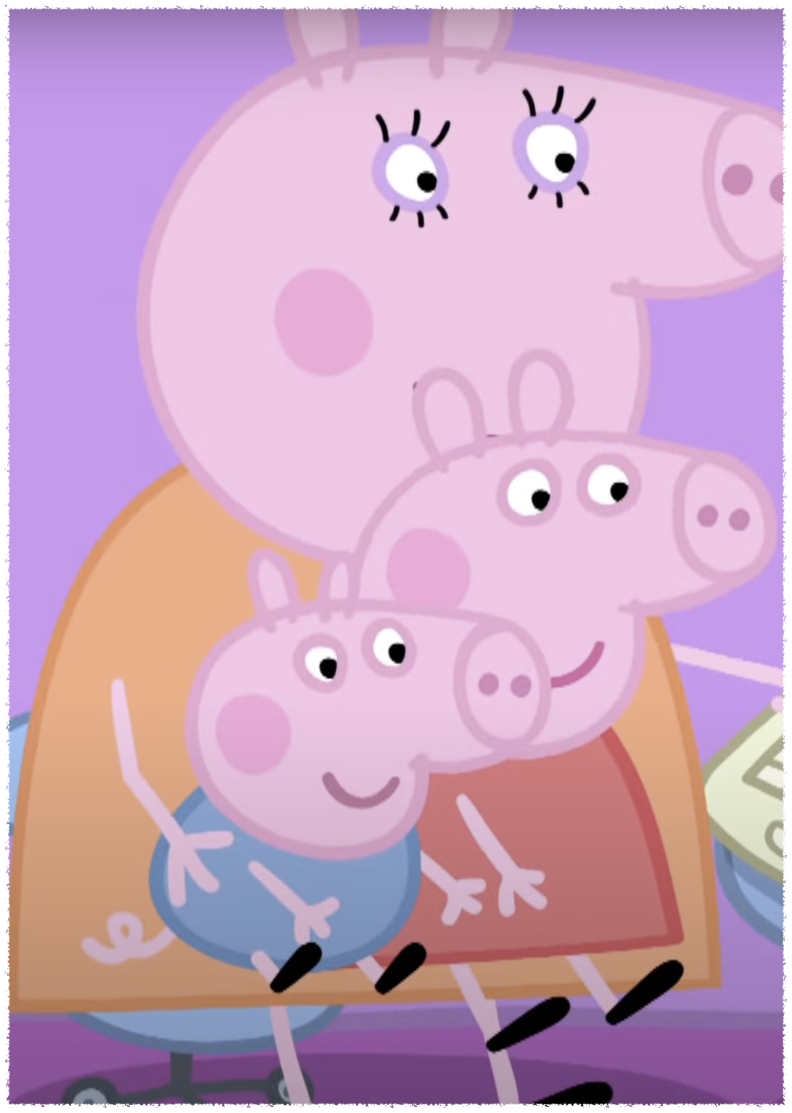
L l
Lunch
Lap
Notes:
Can we sit on your lap?

Slide 7
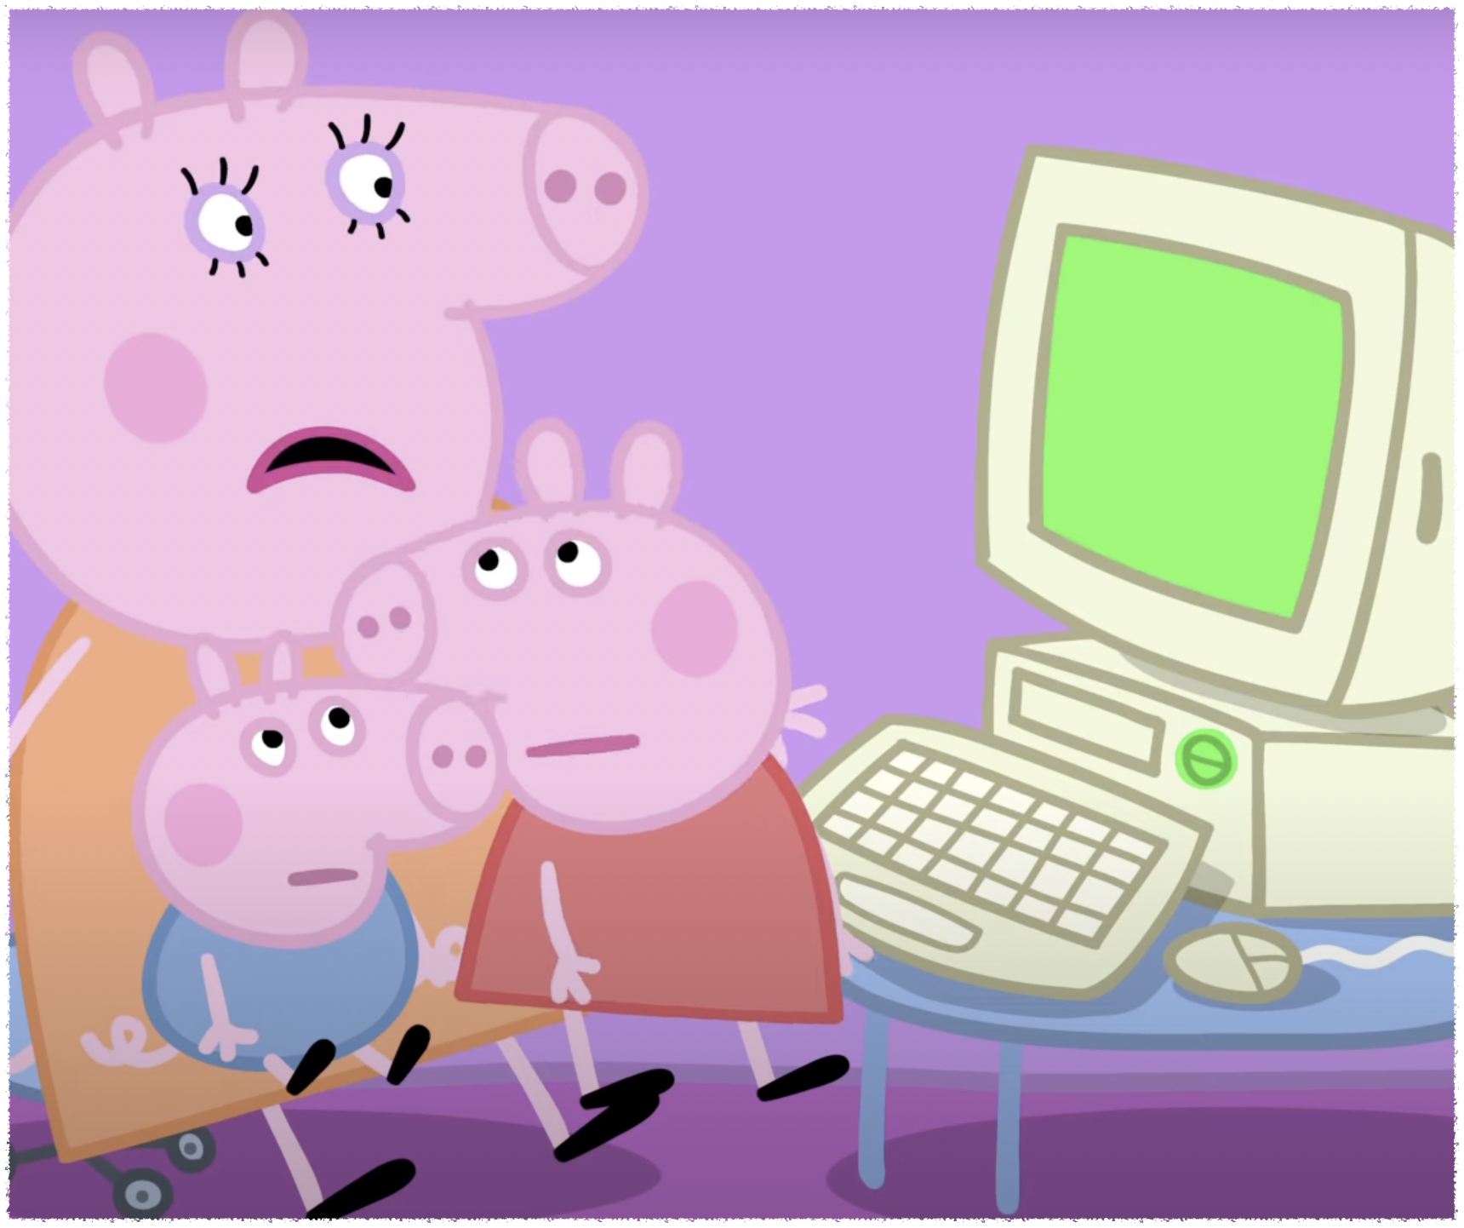
S s
Stop
Soup
Notes:
Stop, you can’t do that

Slide 8

S s
Stop
Soup
Notes:
I will make soup for lunch

Slide 9
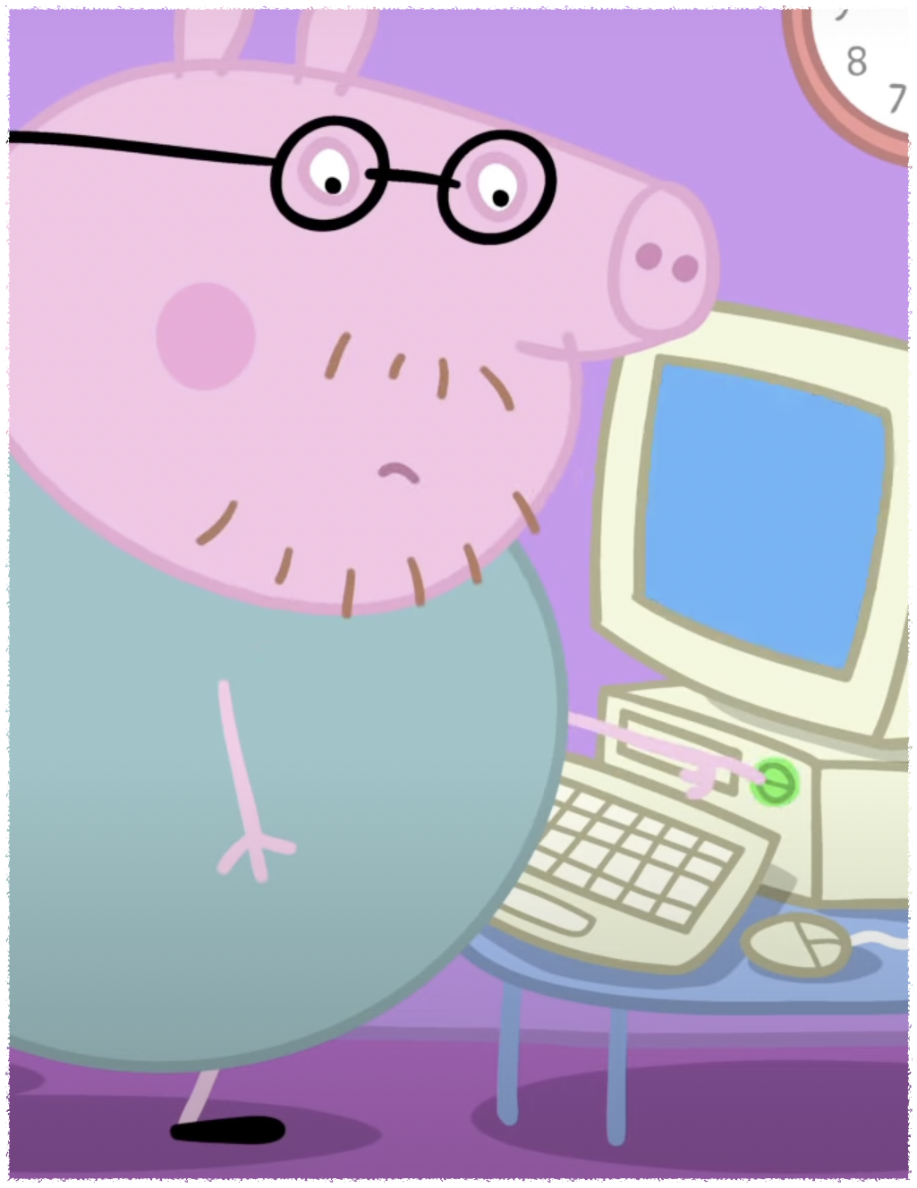
M m
Mend
Notes:
Can you mend the computer?

Slide 10

D d
Disk
Notes:
I don’t know what the disk is

Slide 11
I want to sit on your lap
Can I help you work?
Now it's my turn
What's going on?

